Slide 1
Inventory Management: Drink & Delight
Group C
Tanisha Singh
Pulak Sinha
Sagar Sharma
Shivam Tiwari
Astha

Slide 2
Epic 1: As a supplier, our main aim would be to deliver raw materials as and when required by DD.
User Stories:
As a supplier, I would login using my login credentials.
Then I would accept the request of raw materials from DD
Finally I would upload the details of available materials.

Slide 3
Epic 2: After the payment processing, uploading details for tracking
User Stories:
As a supplier, I would accept payment.
Finally, I would dispatch the order
And update the status of materials for tracking.

Slide 4
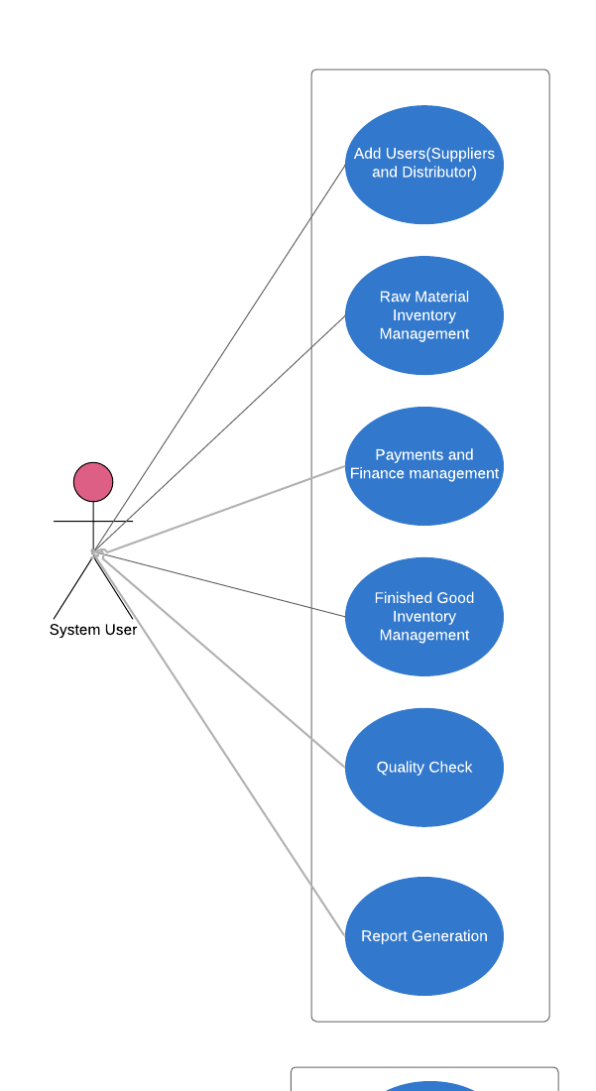
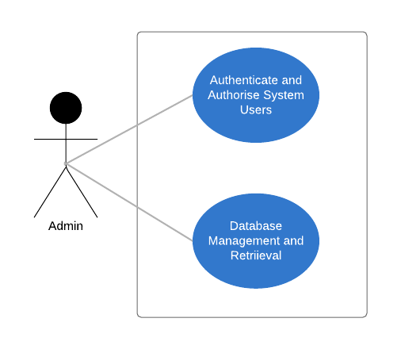
Use Case Diagram Admin and System User

Slide 5
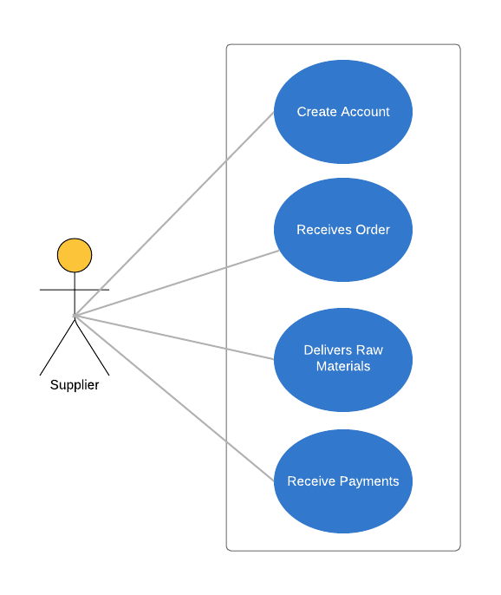
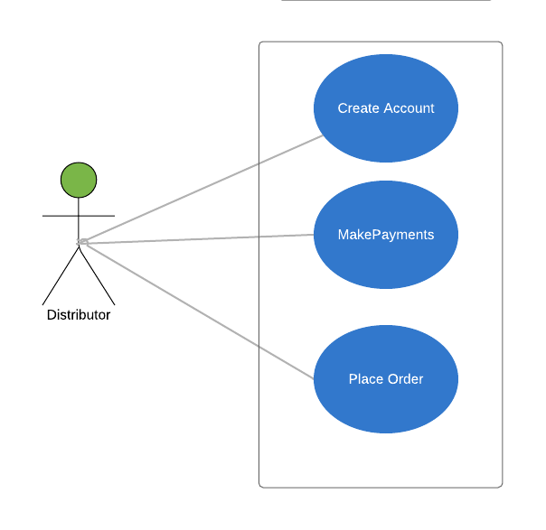
Use Case Diagram Supplier and Distributor

Slide 6
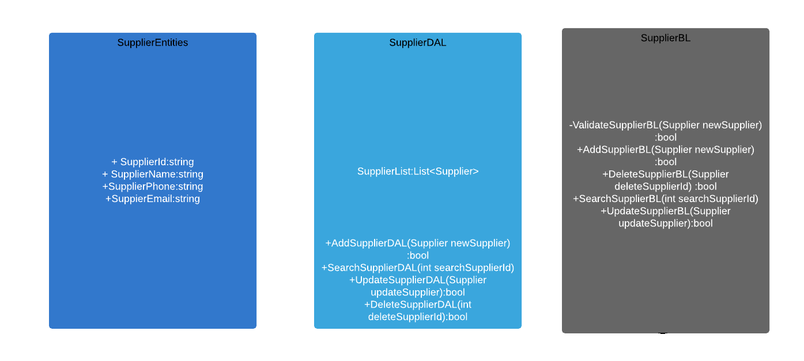
Class Diagram: Supplier

Slide 7
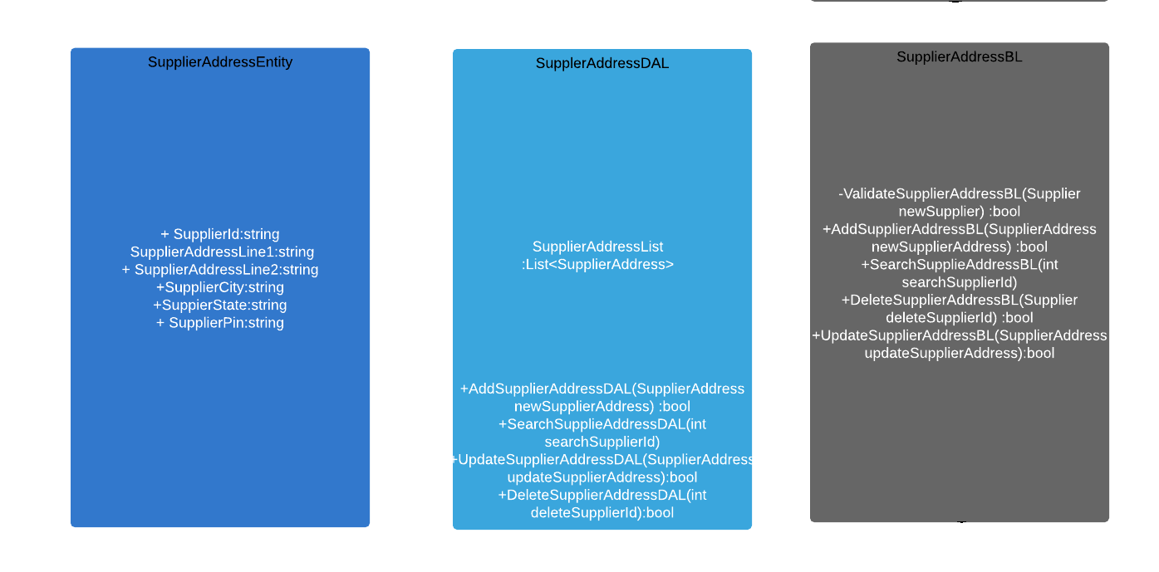
Class Diagram: Supplier Address

Slide 8
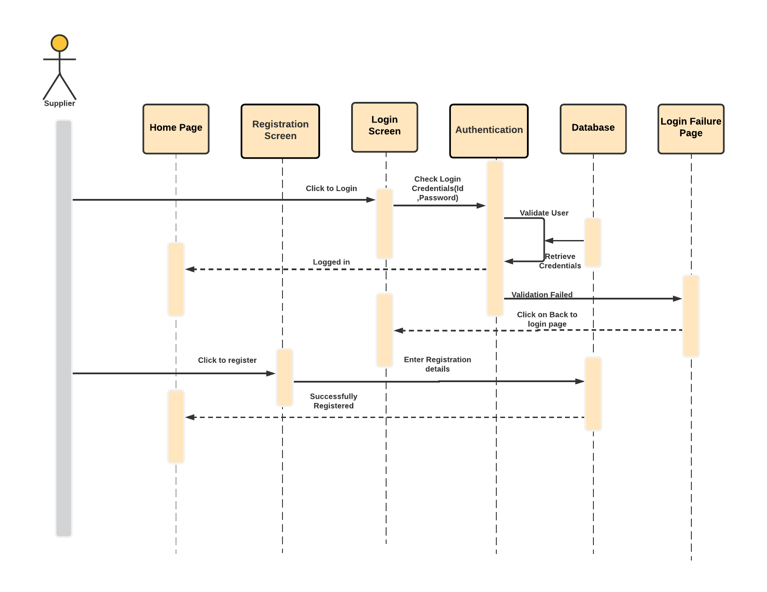
Sequence Diagram: Supplier Login

Slide 9
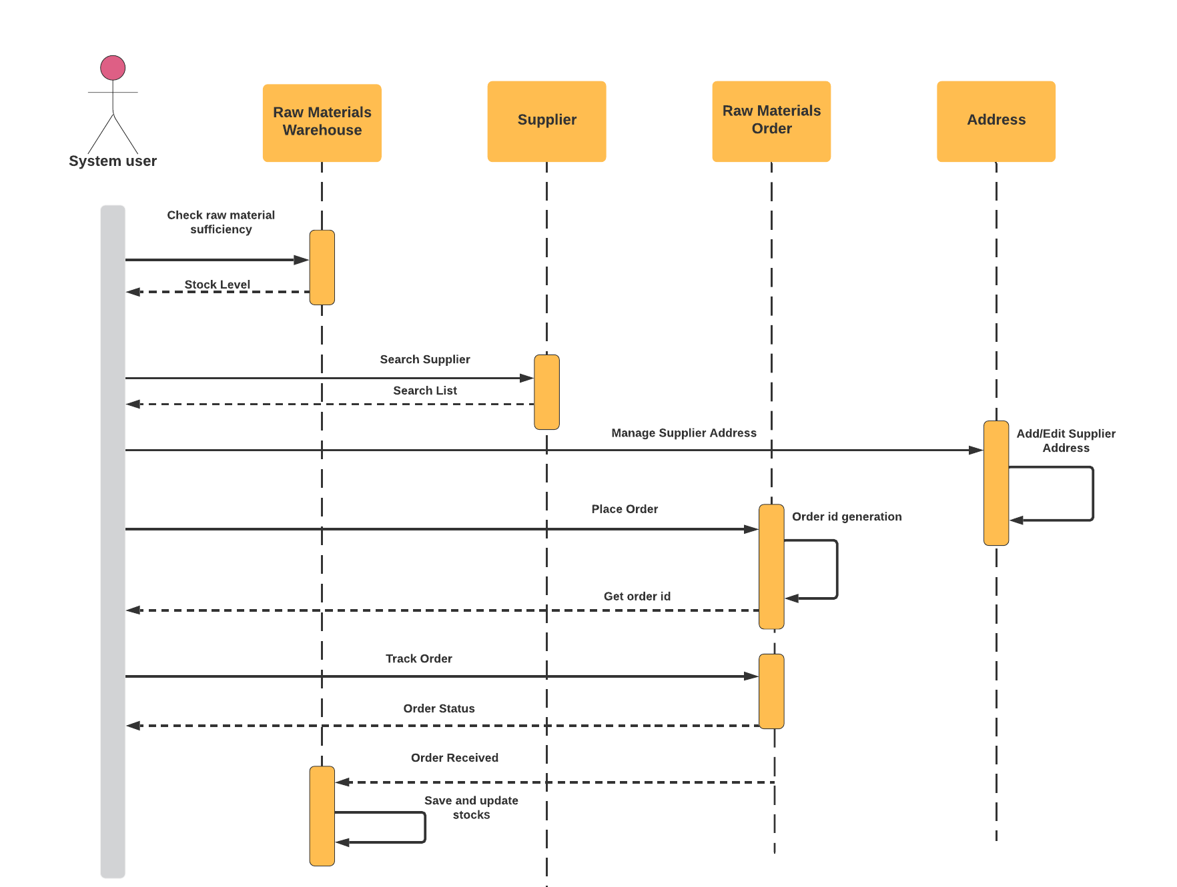
Sequence Diagram: Supplier

Slide 10
Thank You

